Slide 1


FULL STACK DEVELOPMENT USING MERN STACK
SANVI OJHA
12212400
B. Tech (CSE)
Data Science

Slide 2
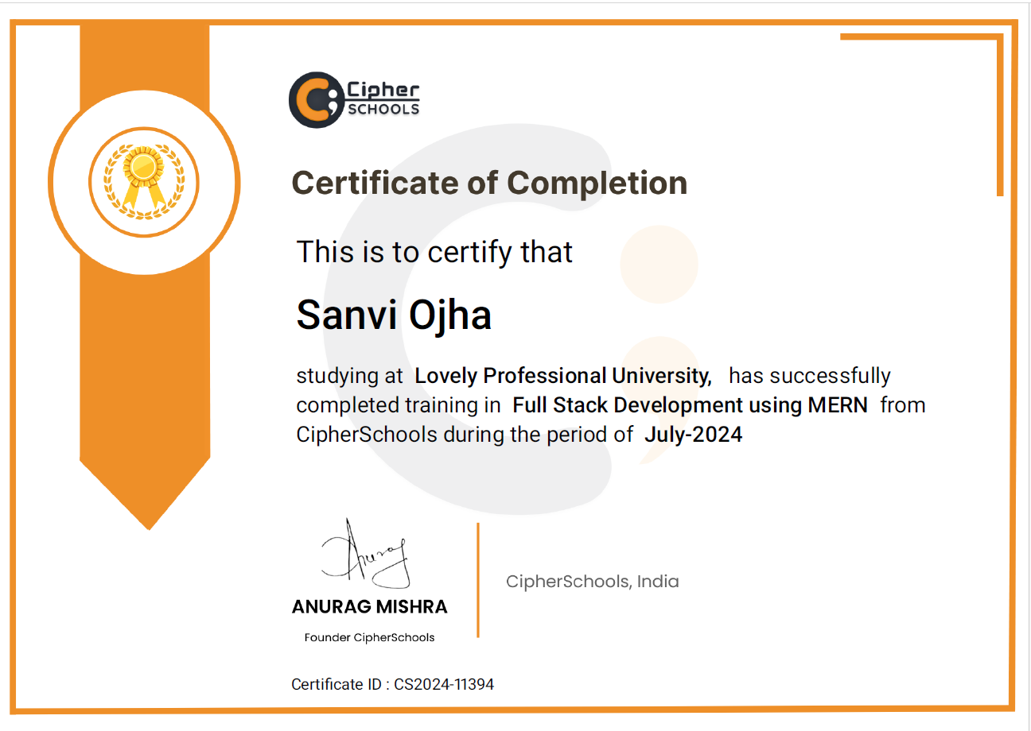

Slide 3
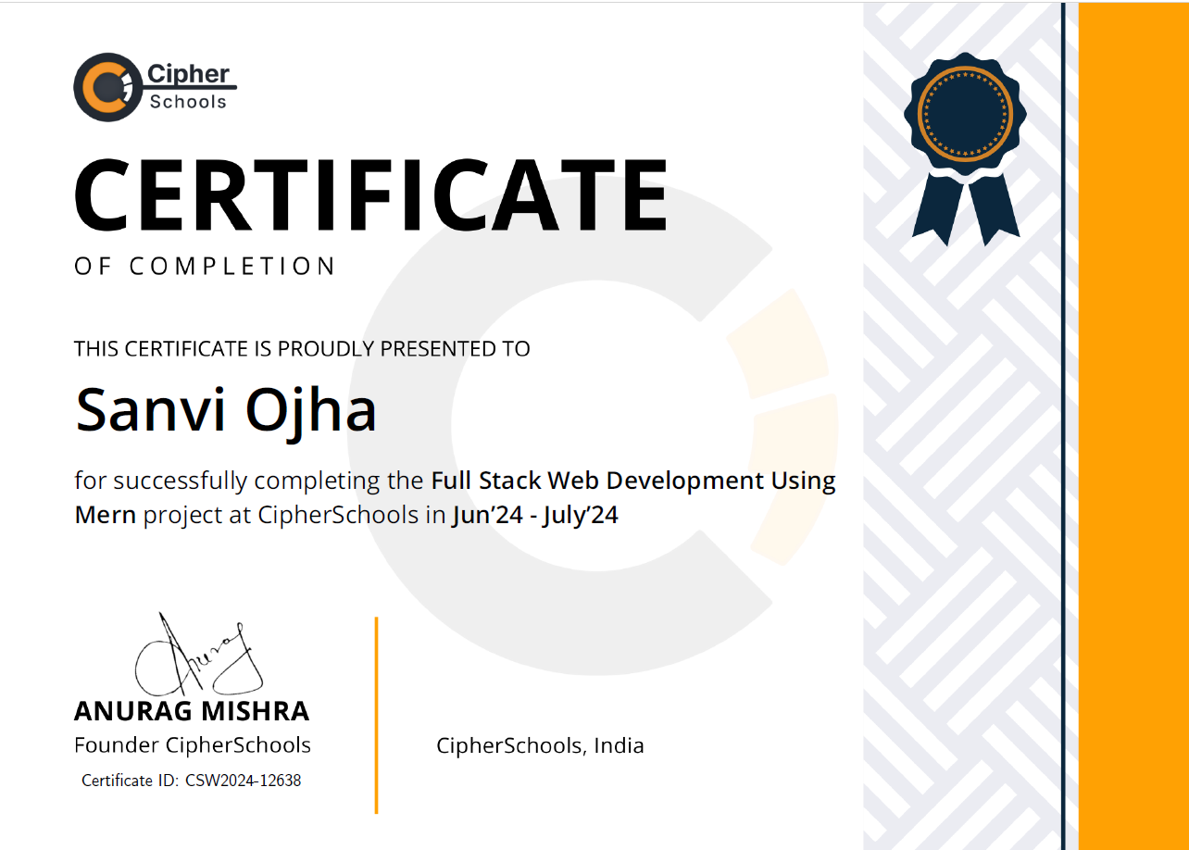

Slide 4
Why did I choose Mern for Summer Training as a data science student….
As a data science student, I chose MERN for my summer training for a few reasons:
Building New Skills: Learning fullstack development will help me integrate my data science projects into web applications, making them easier to use and more interactive.
Flexibility: The MERN stack allows me to create scalable and dynamic apps, which can show data visually or act as platforms for machine learning models.
JavaScript Everywhere: Since MERN uses JavaScript for both frontend and backend, it allows me to work smoothly across the entire project using just one language.
Data Science Integration: I’m curious about how I can combine my data science projects with MERN to build user-friendly apps where people can directly interact with the data and gain insights.

Slide 5
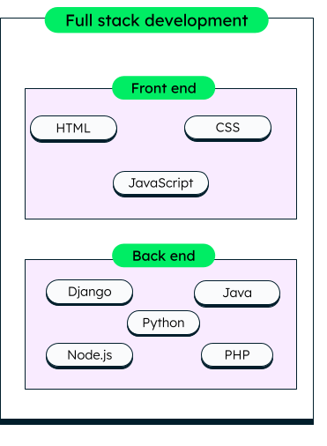
Full Stack Development
Full stack development encompasses the complete process of application software development, including both the frontend and backend development. The front end consists of the user interface (or UI), and the back end handles the business logic and application workflows that run behind the scenes.
Full stack development refers to the development of both the frontend (clientside) and backend (serverside) parts of a web application.

Slide 6
The front end: Crafting engaging user interfaces
The front end is the face of a web application, the part that users interact with directly. But frontend development isn't just about making things look pretty. Full stack developers also focus on usability and accessibility, ensuring the UI is intuitive, easy to navigate, and inclusive to all users, including those with disabilities.
HTML (HyperText Markup Language)
The standard language for creating web pages.
CSS (Cascading Style Sheets)
Used for styling HTML elements to make web pages visually appealing.
JavaScript
A programming language that adds interactivity and dynamic behavior to web pages.

Slide 7
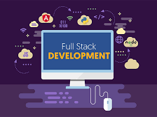
The back end: Powering the application's core
Backend developers play a crucial role in designing and implementing the application's core functionality, handling data management, and ensuring smooth integration with databases like MySQL, MongoDB.
The full stack web developer implements the serverside logic, creates RESTful APIs, and handles data retrieval, manipulation, and storage. They ensure the security and scalability of the backend system, implementing authentication, authorization, and data validation mechanisms.

Slide 8
RESUME
Link-- https://sanviojharesume09.netlify.app/
This project is a React-based single-page application designed to showcase my personal and professional profile. This project serves as an online portfolio, enabling visitors to navigate through various sections that highlight different aspects of my background and skills

Slide 9
TIC-TAC-TOE
LINK----- https://gametictactoest.netlify.app/
[Summary:
State: The game uses React's useState to manage the board, move history, and turns.
Components: The app is broken down into reusable components (Square, Board, TicTacToe).
Functionality:
Players take turns clicking squares to place their marks ("X" or "O").
The game detects winners using calculateWinner().
Players can navigate through the move history and reset the game ]

Slide 10
Tech STACK
Tech Stack: A combination of technologies used to build a web or mobile application. It typically includes:
FrontEnd Framework (e.g., React)
BackEnd Framework (e.g., Express.js)
Database (e.g., MongoDB)
Runtime Environment (e.g., Node.js)
Developers choose stacks that best suit the needs of their project. The term "stack" refers to a set of technologies that work together to support both the frontend and backend of a web app.

Slide 11
MERN Stack
MERN is a popular JavaScript-based full stack development framework used to build dynamic web applications.
It consists of four key technologies: MongoDB, Express.js, React.js, and Node.js.
Key Components of MERN Stack:
1. MongoDB (Database):
Type: NoSQL, document-based database.
Stores data in flexible, JSON-like documents (instead of tables as in traditional relational databases).
Role: Used for storing and retrieving large volumes of data efficiently.
2. Express.js (BackEnd Framework):
Type: Web framework for Node.js.
Simplifies handling of HTTP requests, routes, and middleware(user authentication and data parsing).
Role: Provides a lightweight(less and easy to understand syntax), fast, and scalable framework to manage the server side logic of applications.

Slide 12
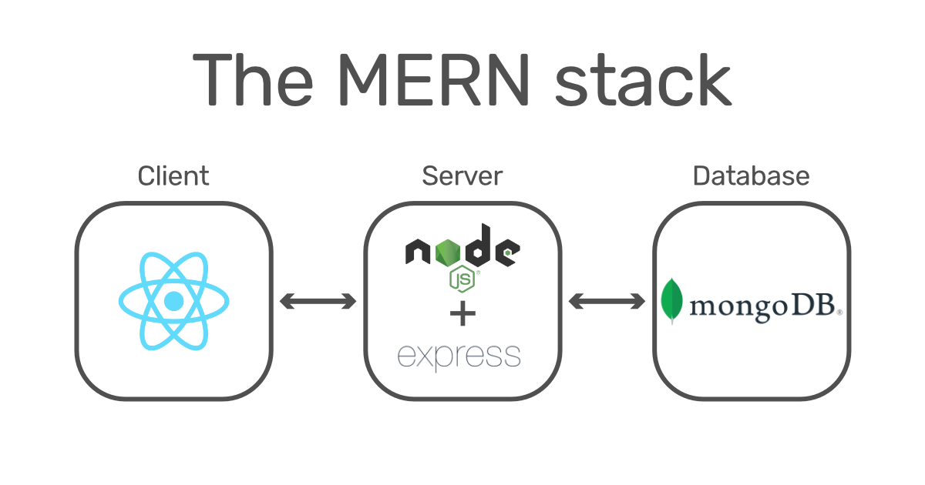

3. React.js (FrontEnd Library):
Type: JavaScript library for building user interfaces.
Purpose: Helps create dynamic, interactive user interfaces with reusable components.
Role: Manages the frontend, providing a smooth, responsive user experience.
4. Node.js (Runtime Environment):
Type: JavaScript runtime built on Chrome’s V8 engine.
Allows JavaScript to be executed on the server.
Role: Acts as the backend environment, handling serverside operations like managing APIs and interacting with the database.

Slide 13
APIs
API: An Application Programming Interface is a set of rules that allows different software applications to communicate with each other.
  Role in MERN Stack: APIs are essential for connecting the frontend (React) with the backend (Node.js and Express.js), allowing data to flow between them.
  RESTful APIs: A common type of API used in web development, where resources (data) are accessed through HTTP requests (GET, POST, PUT, DELETE).
  REST (Representational State Transfer)
  JSON Format: Data is typically exchanged in JSON format, which works well with both MongoDB and JavaScript.
  Usage in Projects: APIs allow you to integrate external services, such as payment gateways, authentication systems, and third-party APIs, to enhance the functionality of web applications.

Slide 14
Use the command: npm create vite
What is Vite?
Vite is a project builder and development tool that allows for faster web development.
It is designed for modern front-end frameworks like React, Vue, etc.
Advantages of Vite:
Lazy Loading: Vite only loads the components that are necessary, improving performance. This means that it only fetches what’s needed at the moment, ensuring faster load times.
In terminal npm create vite(What is NPM? NPM is a node package manager for Node.js packages, or modules ) project name selecting framework react variant--javascript
Understanding package.json:
The package.json file contains:
Dependencies: Lists all the libraries and packages that the project depends on.
Project Metadata: Includes details like the project name, version, description, etc.
Version Flexibility: For example, if the dependency version is listed as 1.2.3, you can install versions up to 1.3.0.
Command to Create a React Project

Slide 15
Understanding package-lock.json:
Exact Version Control: It guarantees that the project will use the exact same versions of the dependencies listed.
Exact Data: This file locks the exact version of each installed dependency, ensuring the same versions are installed whenever the project is set up again.

Slide 16
THANK YOU

